Slide 1

SAINTGITS
COLLEGE OF ENGINEERING
(AUTONOMOUS)
PROJECT PHASE - II
Final Internal Review
TweetPulse: A Power BI-Driven Interactive Sentiment Analysis Dashboard for Brand Monitoring
Project Guide:
Er. Talit Sara George Assistant Professor Department of Computer Science and Engineering
Team Members:
Ajith M Joshy (MGP21UCS017)
Jerry Narakathara Thomas (MGP21UCS071)
Anitta Mary Jose (MGP21UCS033)

Slide 2
CONTENTS
Introduction
Literature Review
Formulation of Project Plan
Existing Systems
Proposed System
Methodology
Results & Discussion
Conclusion
References
2/19

Slide 3
Introduction
The objective of this project is to develop a Real-time system that analyzes Twitter data using the hashtag #Apple to assess public sentiment toward the Apple brand.
This system aims to provide valuable insights into sentiment trends, helping Apple with reputation management and the strategic alignment of marketing campaigns through continuous monitoring and analysis of social media sentiment in an interactive and dynamic dashboard.

Slide 4
LITERATURE REVIEW
Sl no: | Research Paper | Techniques Used | Dataset | Summary points
1. | Using Artificial Intelligence to Understand What Causes Sentiment Changes on Social Media | Filtered-LDA: A cascaded LDA model to detect emerging topics while filtering out old ones. VADER: Selected for sentiment analysis due to its performance on short texts | US Airlines Twitter Dataset: 14,640 labelled tweets. Stanford Twitter Dataset (STD-2009):476 million tweets from 2009 | Result: Filtered-LDA framework effectively detected emerging topics and reasons for sentiment changes on Twitter. Output: VADER was chosen for sentiment classification; Filtered-LDA provided accurate, interpretable reasons for sentiment variations. Gaps: Learning-based classifiers struggled with cross-domain accuracy; focus was on English tweets only. Findings: Filtered-LDA outperformed traditional methods and ensured accurate detection of sentiment reasons.
2. | COVID-19 Sensing: Negative Sentiment Analysis on Social Media in China via BERT Model | BERT Model: Fine-tuned for sentiment classification (positive, neutral, negative) on Weibo posts. TF-IDF: Used to extract topics from the posts and perform thematic analysis.) | Weibo Posts: 999,978 COVID-19 related Weibo posts (January 1 - February 18, 2020 | Result: The fine-tuned BERT model achieved 75.65% accuracy in classifying sentiment from Weibo posts. Output: Identified 11 key topics related to negative sentiment, covering themes like virus origin, symptoms, and public health control. Gaps: Limited to Weibo data; other social media platforms were not considered, potentially causing bias. Findings: Public sentiment spikes were linked to significant COVID-19 events, providing insights into managing public concerns.

Slide 5
Sl no: | Research Paper | Techniques used | Dataset | Summary points
3. | Enhancing Sentiment Analysis on social media with Advanced Deep Learning Techniques | Advanced preprocessing, TF-IDF, Word2Vec, GloVe, BiLSTM, CNN-LSTM models with GridSearchCV optimization. | Sentiment 140 with 1.6M labeled tweets​ | Results/Output: The BiLSTM model with GloVe embeddings achieved the highest accuracy (88.88%) and outperformed prior methods on the Sentiment140 dataset. Gaps: Traditional methods struggle with the evolving language of social media; further work is needed in multilingual and transformer-based models. Findings: Advanced deep learning techniques (BiLSTM, CNN-LSTM) significantly improve sentiment analysis, especially with optimized feature extraction like Word2Vec and GloVe
4. | Sentiment Analysis Predictions in Digital Media Content using NLP Techniques | BERT, Random Forest, KNN, LSTM, and other machine learning models for sentiment analysis. Preprocessing techniques like TF-IDF, Word2Vec, and BERT were applied for feature extraction. | Twitter dataset from Kaggle with 160,000 tweets, categorized as positive, negative, and neutral​ | Results/Output: BERT model achieved the highest accuracy (94.56%), while the LSTM model excelled in recall, precision, and F1 score. Random Forest performed best among traditional models. Gaps: Focus on Twitter data and binary sentiment analysis limits generalizability. More diverse datasets and model comparisons are needed. Findings: Deep learning models, especially BERT and LSTM, significantly outperform traditional machine learning models for sentiment analysis​

Slide 6
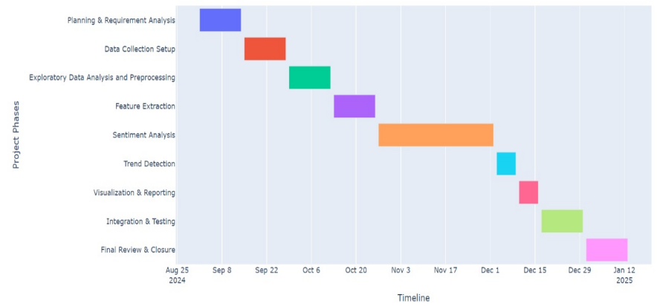
Formulation of Project Plan
PHASE 1 PROJECT PLAN

Slide 7
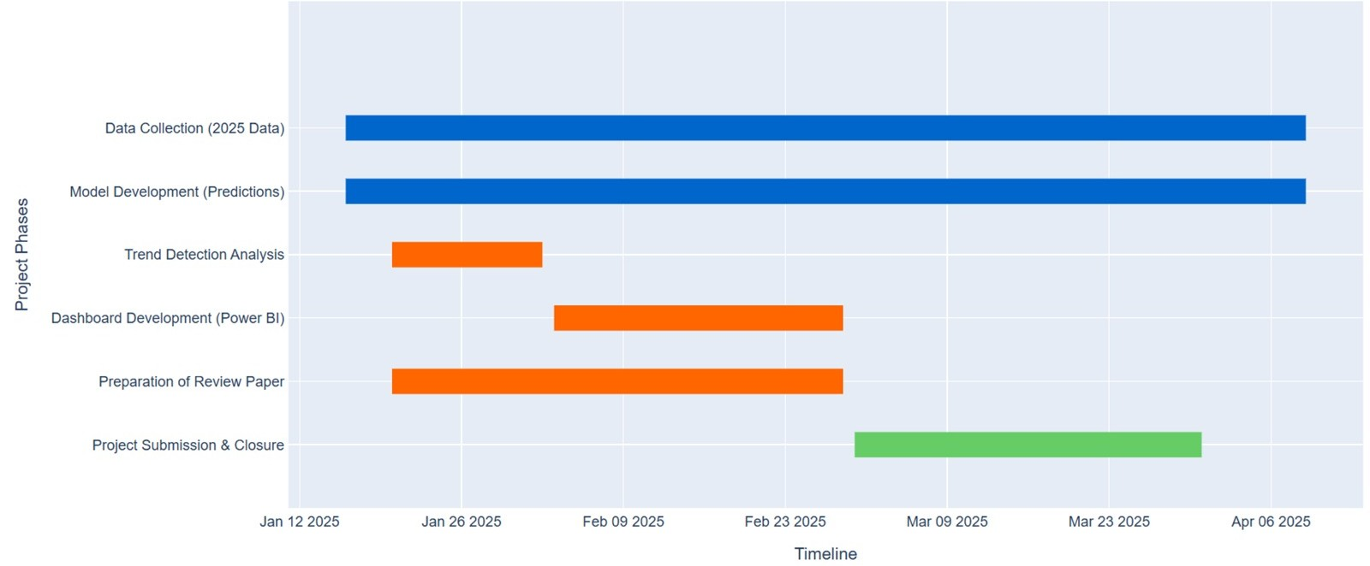
Formulation of Project Plan
PHASE 2 PROJECT PLAN

Slide 8
Existing System
Current approaches to sentiment analysis on social media primarily rely on static datasets obtained from sources such as Twitter, Facebook, and other social platforms. These datasets are often collected in advance and consist of past interactions, which makes them useful for historical sentiment analysis but limits their capacity to capture real-time sentiment shifts.
Existing workflows handle general sentiment trends but lack continuous, live analysis, missing immediate sentiment shifts.
Visualization tools are often spread out, lacking a unified dashboard for easy, comprehensive trend monitoring.
Limitations
Lack of Real-time analysis
Limited trend detection and emerging topic identification
Reduced insight relevance over time
Fragmented visualization

Slide 9
Proposed System
We propose to build a system that overcomes the limitations of traditional sentiment analysis approaches by implementing a real-time sentiment analysis pipeline specifically designed for continuous monitoring of Twitter data related to the Apple brand. This system streams live tweets using the hashtag tweets, e.g. #Apple, enabling immediate analysis and insights from current public sentiment.
Tweets are preprocessed and feature-extracted using methods like TF-IDF, then classified with machine learning models (e.g., Logistic Regression, XGBoost) to provide reliable sentiment categorization.
A real-time, interactive dashboard displays sentiment trends and insights, allowing Apple’s brand managers to detect emerging patterns and make informed, data-driven decisions quickly.
Features
Real-time analysis
Continuous trend detection
Dynamic visualization
Enhanced decision-making support

Slide 10
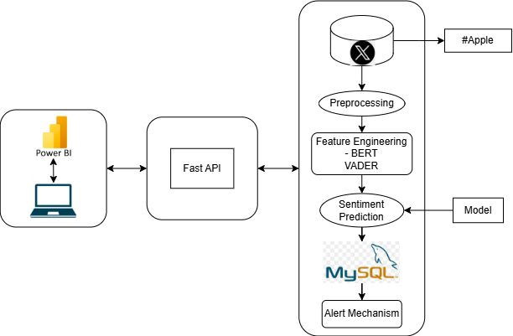
Proposed System

Slide 11
Methodology
Data Acquisition: The process starts with acquiring data from Twitter using the Twikit web scraper. Here, tweets are collected with the hashtag #Apple to create a dataset reflecting public sentiment towards Apple.
Exploratory Data Analysis: In this stage we explore our dataset and check for any missing values. This stage can be done at any part of our system workflow in order to assess the quality of our dataset.
Preprocessing: Before analysis, the raw text data needs to be cleaned and standardized through preprocessing. This step is crucial for transforming unstructured text data into a form that machine learning models can effectively process. The specific steps are Tokenization, Removing stopwords, links, alphanumeric characters and special symbols and lemmatization.
4. Feature Extraction: It involves transforming raw data into a structured set of informative variables, known as features, that can
effectively represent patterns and trends within the dataset. The feature extraction techniques are implemented using BERT model and VADER.
5. Model Training: The combined features from BERT, and VADER sentiment scores are used to train machine learning models to predict sentiment. Four models are trained: Logistic Regression, Support Vector Machine, and Random Forest and XGBoost.
6. Testing and Evaluation: The evaluation process involves feeding the test set into the model and measuring performance metrics, such as accuracy, precision, recall, and F1 score.

Slide 12
7. Sentiment Analysis: Once the model is trained and evaluated, the model is saved so we does not need to retrain the model everytime and instead it is applied to classify the sentiment of new tweets in real time. This involves processing incoming tweets, extracting features, and generating a sentiment label (positive, negative, or neutral) for each tweet, allowing for continuous tracking of public sentiment.
8. Visualizations: PowerBI, an interactive and dynamic dashboard is developed to view and represent all findings together. These visualizations provide a clear picture of the data’s sentiment and help reveal patterns and trends that might have otherwise been missed. By using charts, graphs, and other visual tools, the results can be presented in a compelling and easy-to-understand manner, enabling better-informed decisions based on the data analysis.
9. Trend Detection: Different trends can be visualized in dashboard such as sentiment(positive, negative and neutral), hashtags and keywords trends. These trends are detected and notified using an alert mechanism through email to the stakeholder, when the particular trend crosses certain threshold.

Slide 13
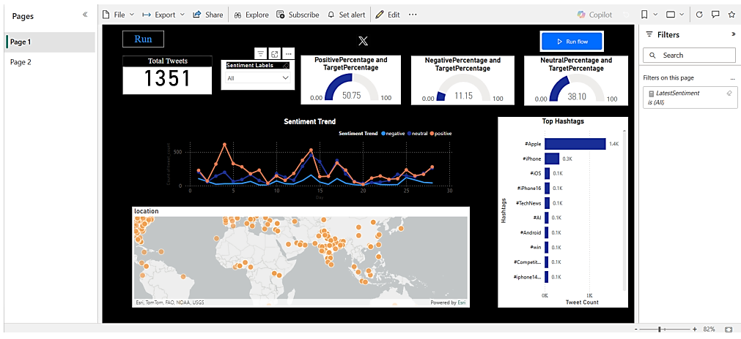
Results & Discussion
In this section:
The insights obtained from different visuals used in dashboard, are explained
Brand Monitoring Dashboard

Slide 14
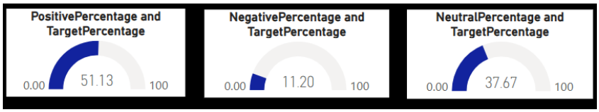
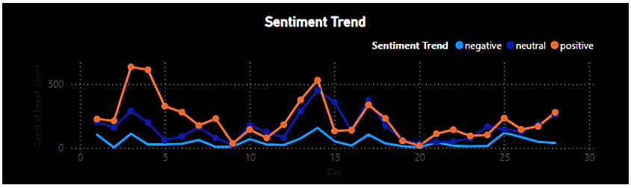
The positive, negative and neutral sentiment percentages of the total collected tweet is shown in below figure. It helps to understand in overall how customers are reacting towards the brand, using the Brand Monitoring Dashboard if they are satisfied or dissatisfied.
Percentage of Positive, Negative and Neutral Sentiments
The trend of different sentiment categories is shown in the figure. It shows how different sentiments vary throughout the timeline. The x-axis represents each day and y-axis represents the count of collected data. The sentiment variation also depends on how much data is collected each day, as tweets are not collected the same amount everyday
Sentiment Trend

Slide 15
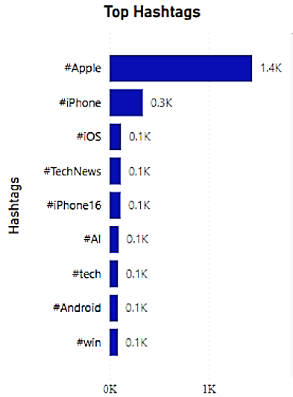
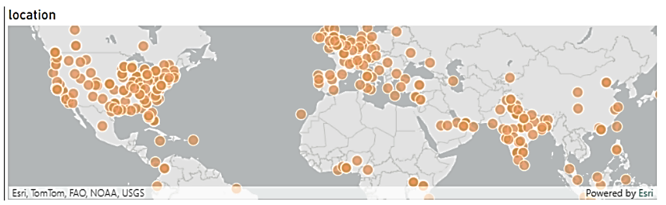
Location of Tweets
Trending Hashtags
The Top hashtags as shown in above figure, tell the hashtags that have been used by the users the most. The count of hashtags are presents in the decreasing order from the top. It gives an idea on how to reach maximum people using these hashtags.
The above figure shows the location of the users whose tweets are collected. Sometimes, it displays the name of the country or state and does not go deep into the address of the users. This location feature is provided by the dashboard.

Slide 16
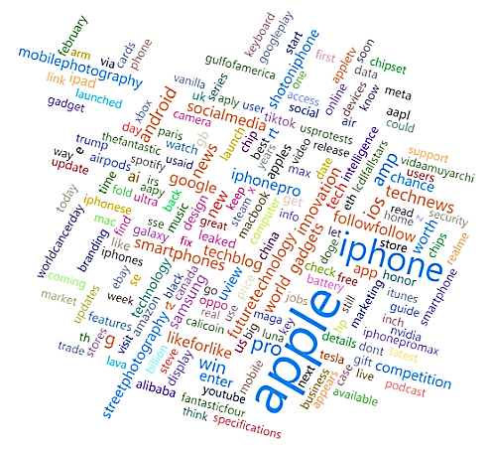
A visual providing the keywords that are used the most by users are provided in figure. The keywords that are in large size show the keyword that has been used the most by users, and the keywords that are least in size show that they are used the least by users, and the count of each keywords can be known by putting the mouse cursor on top of the keyword.
Word Cloud

Slide 17
Conclusion
In this project, we successfully implemented a real-time sentiment analysis pipeline to analyze Twitter data related to the Apple brand. By leveraging multiple machine learning models and feature engineering techniques, VADER and BERT, we were able to classify tweets as positive, neutral, or negative with reasonable accuracy.
However, several challenges arose during the project, including the inherent difficulty in handling imbalanced class distributions and the limitations of feature engineering methods when applied to noisy social media data. Despite these challenges, the project demonstrated that real-time sentiment analysis can be effectively applied to Twitter data, providing valuable insights into public sentiment around brands like Apple.
Overall, this project not only showcased the feasibility of real-time sentiment analysis but also highlighted the areas in which sentiment analysis models can be further optimized for practical applications in brand management and public relations.

Slide 18

REFERENCES
J. Park. (2020). "Framework for Sentiment-Driven Evaluation of Customer Satisfaction With Cosmetics Brands," in IEEE Access, vol. 8, pp. 98526-98538, doi: 10.1109/ACCESS.2020.2997522.keywords:
F. Alattar and K. Shaalan. (2021). "A Survey on Opinion Reason Mining and Interpreting Sentiment Variations," in IEEE Access, vol. 9, pp. 39636-39655,, doi: 10.1109/ACCESS.2021.3063921.keywords:
S. Shayaa et al. (2018). "Sentiment Analysis of Big Data: Methods, Applications, and Open Challenges," in IEEE Access, vol. 6, pp. 37807-37827, 2018, doi:10.1109/ACCESS.2018.2851311.keywords:
P. K. Soni and R. Rambola. (2022)."A Survey on Implicit Aspect Detection for Sentiment Analysis: Terminology, Issues, and Scope," in IEEE Access, vol. 10, pp. 63932-63957, doi:10.1109/ACCESS.2022.3183205.keywords:

Slide 19
Rhea Mahajan and Vibhakar Mansotra, “Correlating Crime and Social Media: Using Semantic Sentiment Analysis” International Journal of Advanced Computer Science and Applications(IJACSA), 12(3), 2021. http://dx.doi.org/10.14569/IJACSA.2021.0120338
Sangeeta Rani, Nasib Singh Gill and Preeti Gulia, “Survey of Tools and Techniques for Sentiment Analysis of Social Networking Data” International Journal of Advanced Computer Science and Applications(IJACSA), 12(4), 2021. http://dx.doi.org/10.14569/IJACSA.2021.0120430
EL FALAH Zineb, RAFALIA Najat and ABOUCHABAKA Jaafar, “An Intelligent Approach for Data Analysis and Decision Making in Big Data: A Case Study on E-commerce Industry” International Journal of Advanced Computer Science and Applications(IJACSA), 12(7), 2021. http://dx.doi.org/10.14569/IJACSA.2021.0120783
Nethravathy Krishnappa, D Saraswathi and Chandrasekar Chelliah, “Exhaustive Insights Towards Social-Media Driven Disaster Management Approaches” International Journal of Advanced Computer Science and Applications(IJACSA), 15(5), 2024. http://dx.doi.org/10.14569/IJACSA.2024.0150577

